Slide 1
Dynamics and Mechanics of Rods(2nd)
By JunAng Wang
2023/10/27

Slide 2
Recap
Three dimensional continua and one dimensional continua
The Lagrange coordinate and Mechanics of a Rod
The difficulty of small scale rod simulation
Approximation method
Mechanics and Dynamics of Rods

Slide 3
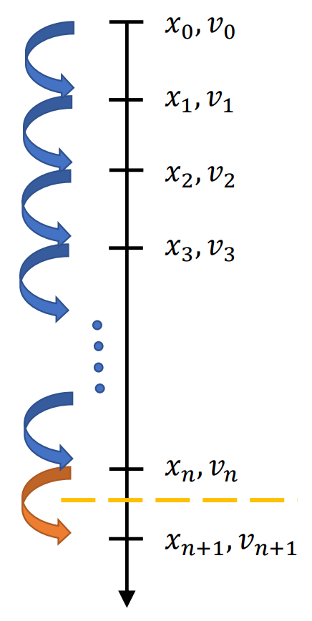
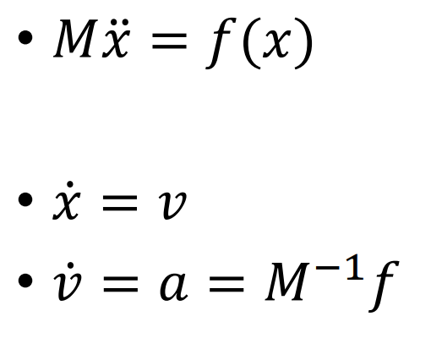
Recap
Laws of physics

Slide 4
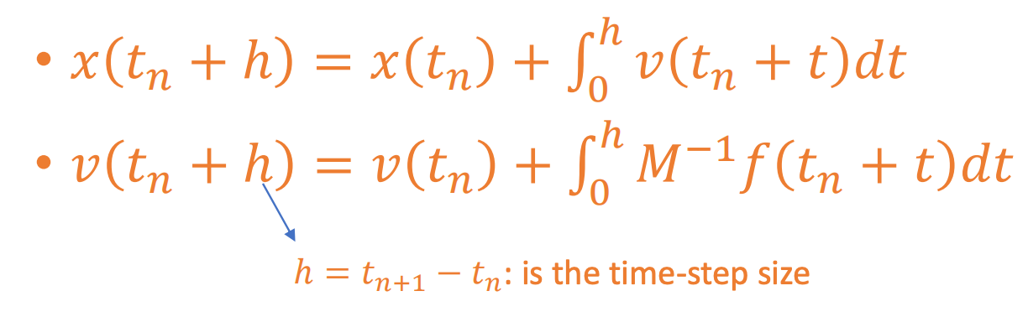
Recap
Laws of physics

Slide 5
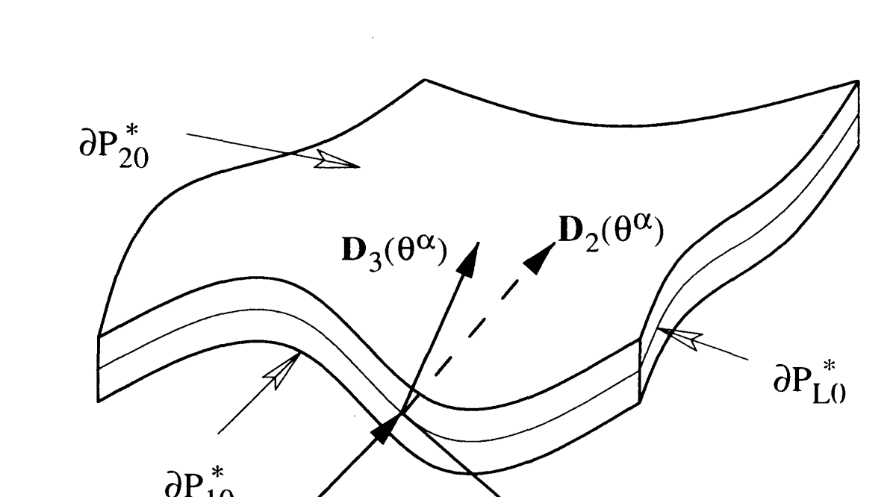
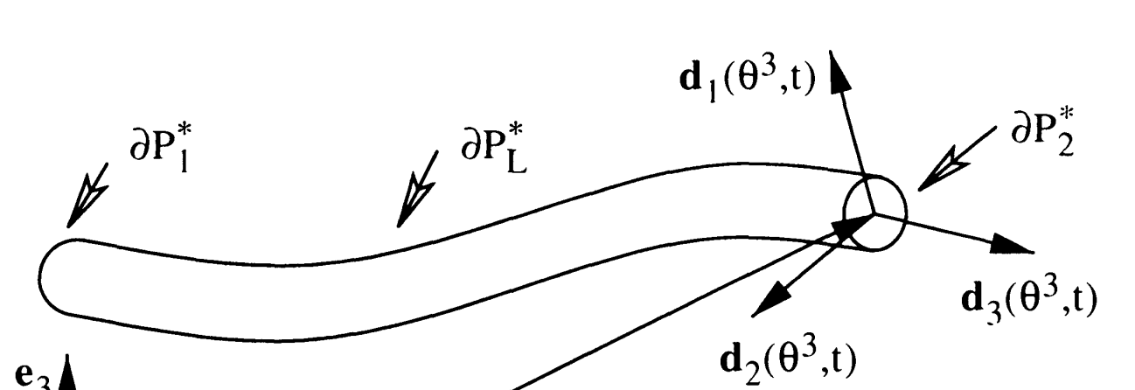
3D continua and 1D continua
M. B. Rubin, Cosserat Theories: Shells, Rods and Points

Slide 6
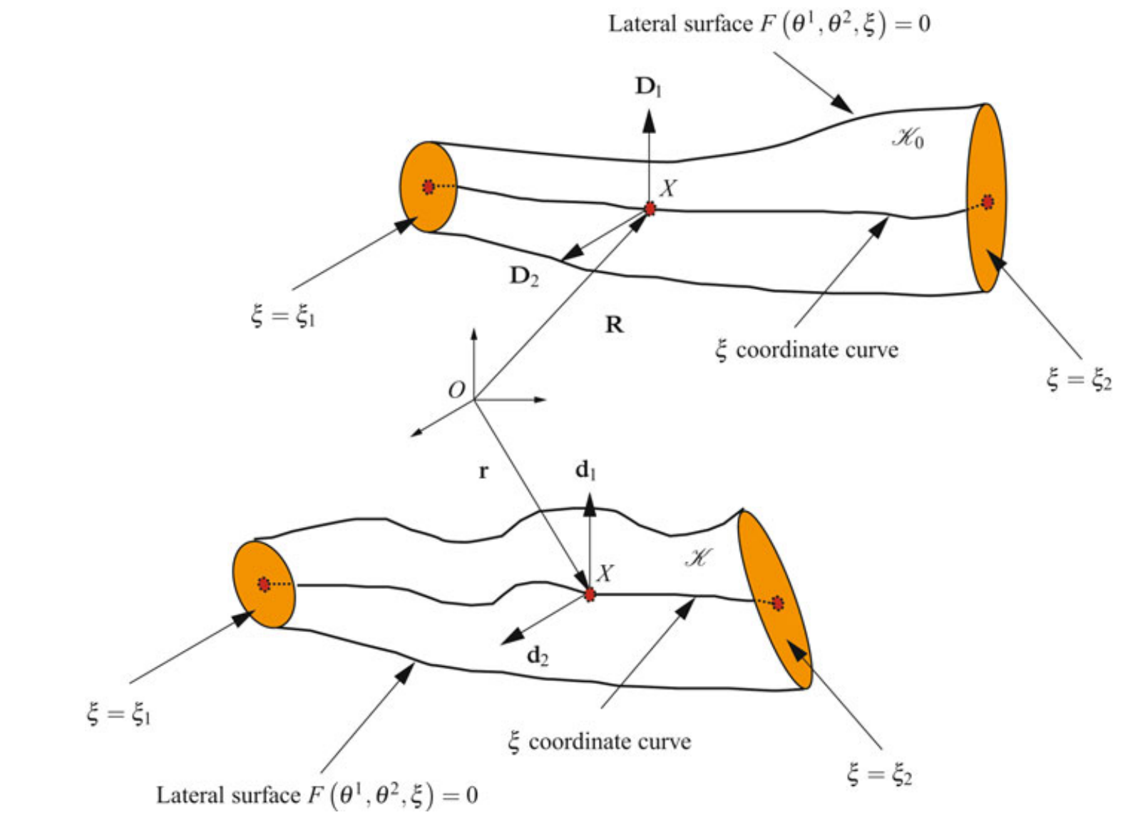
3D continua and 1D continua
M. B. Rubin, Cosserat Theories: Shells, Rods and Points

Slide 7
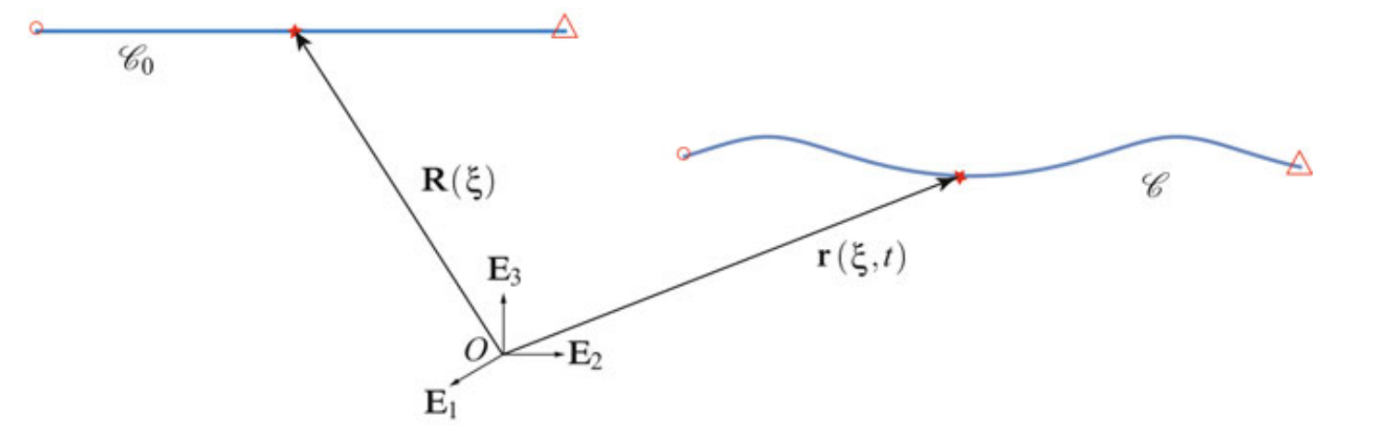
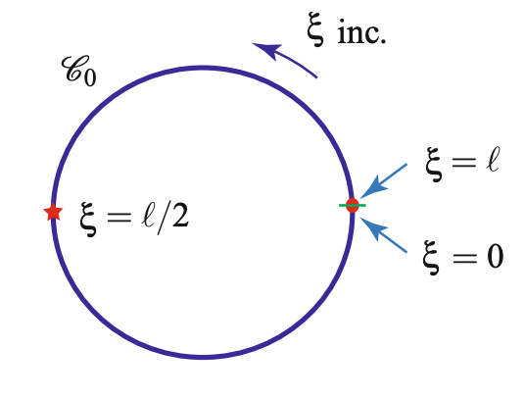
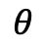
The Lagrange coordinate
$$θ$$
M. B. Rubin, Cosserat Theories: Shells, Rods and Points

Slide 8
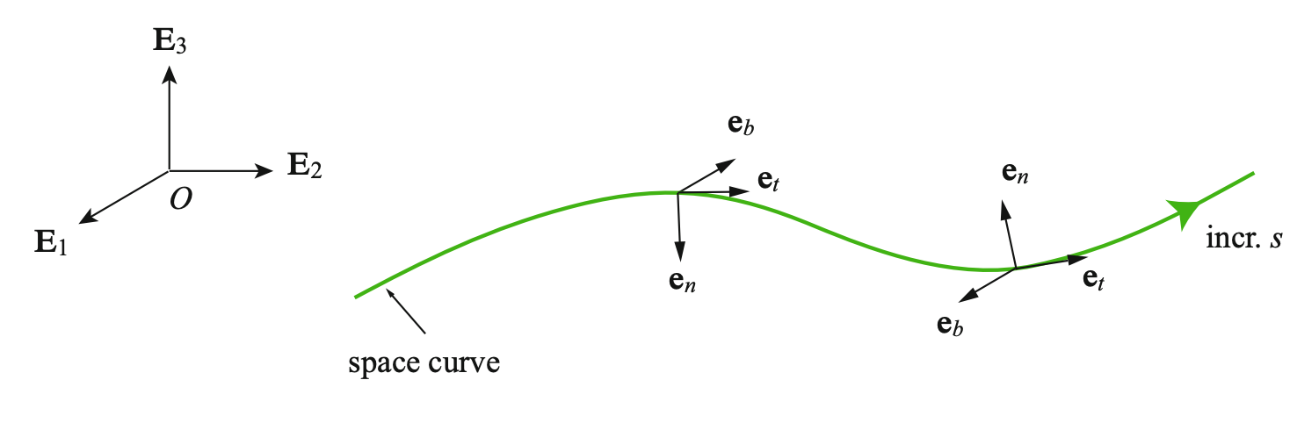
The Lagrange coordinate
M. B. Rubin, Cosserat Theories: Shells, Rods and Points

Slide 9
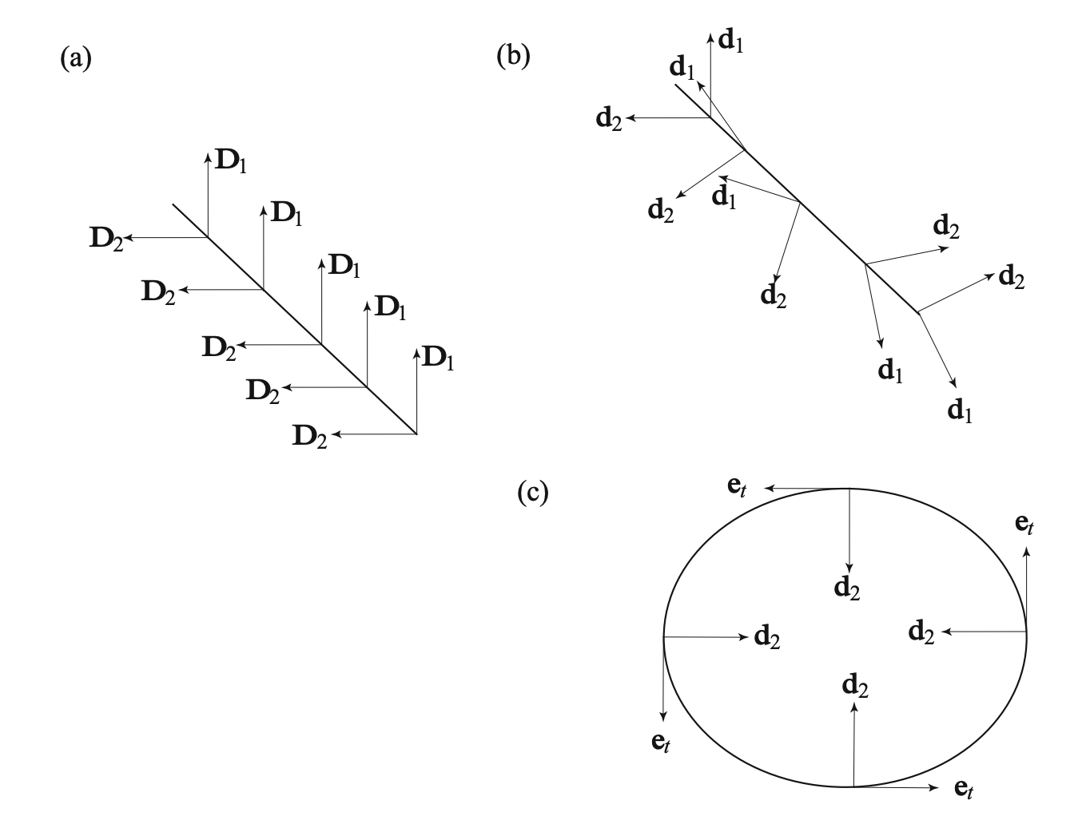
The Lagrange coordinate
M. B. Rubin, Cosserat Theories: Shells, Rods and Points

Slide 10
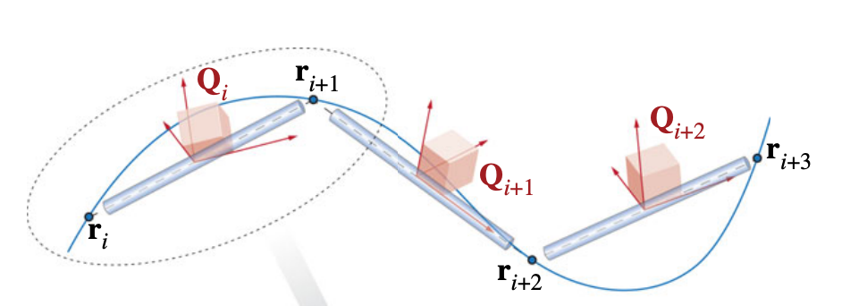
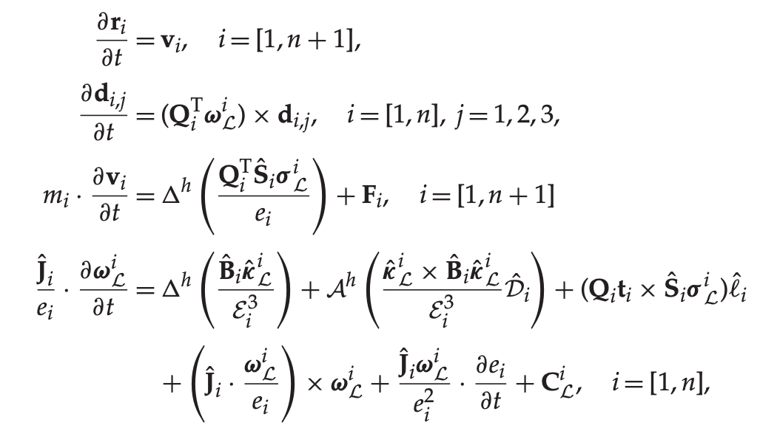
Mechanics of a Rod
M. B. Rubin, Cosserat Theories: Shells, Rods and Points

Slide 11
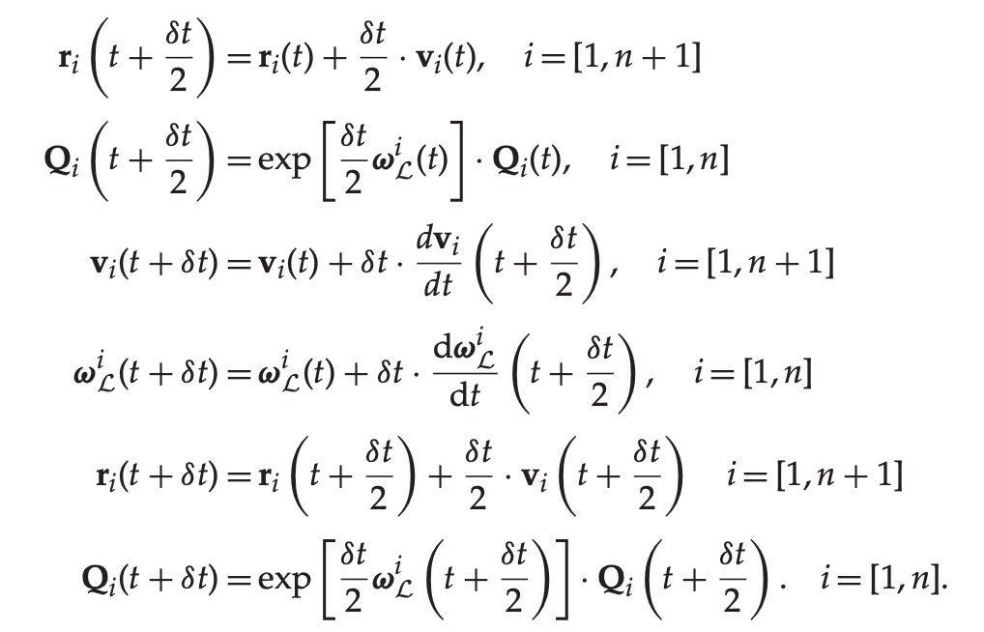
Time Integration (Symplectic, Verlet integrator)
M. B. Rubin, Cosserat Theories: Shells, Rods and Points

Slide 12
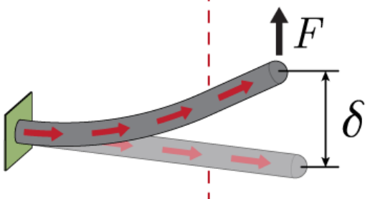
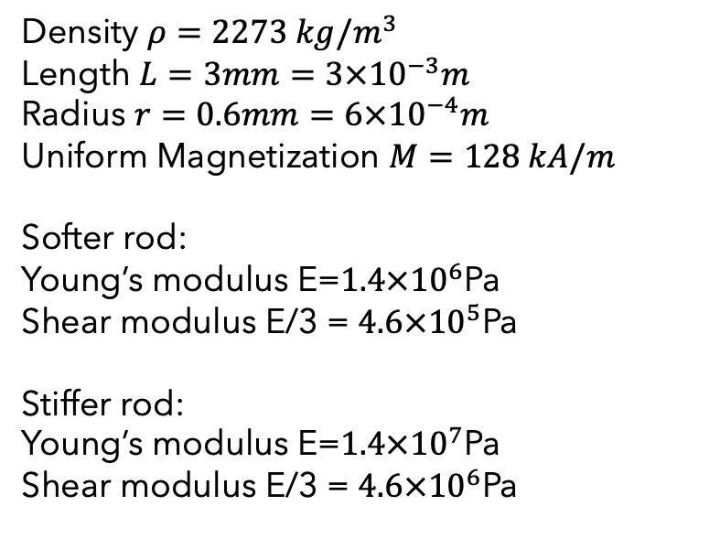
What we are studying at?
Density $ρ=2273 kg/m^{3}$
Length $L=3mm=3×{10}^{−3}m$
Radius $r=0.6mm=6×{10}^{−4}m$
Uniform Magnetization $M=128 kA/m$
Softer rod:
Young’s modulus E=$1.4×{10}^{6}$Pa
Shear modulus E/3 = $4.6×{10}^{5}$Pa
Stiffer rod:
Young’s modulus E=$1.4×{10}^{7}$Pa
Shear modulus E/3 = $4.6×{10}^{6}$Pa
Yoonho Kimet al. 2019

Slide 13
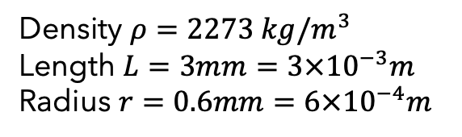
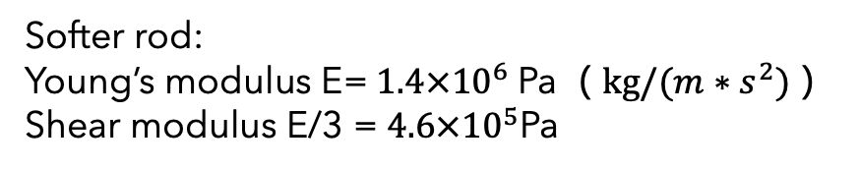
The difficulty of small scale rod simulation
（1）
Softer rod:
Young’s modulus E=$1.4×{10}^{6}$Pa（$kg/(m∗s^{2})$）
Shear modulus E/3 = $4.6×{10}^{5}$Pa
（2）
Density $ρ=2273 kg/m^{3}$
Length $L=3mm=3×{10}^{−3}m$
Radius $r=0.6mm=6×{10}^{−4}m$

Slide 14
The difficulty of small scale rod simulation
（1）
Softer rod:
Young’s modulus E=$1.4×{10}^{6}$Pa（$kg/(m∗s^{2})$）
Shear modulus E/3 = $4.6×{10}^{5}$Pa
（2）
Density $ρ=2273 kg/m^{3}$
Length $L=3mm=3×{10}^{−3}m$
Radius $r=0.6mm=6×{10}^{−4}m$
double-precision float arithmetic issues !!!

Slide 15
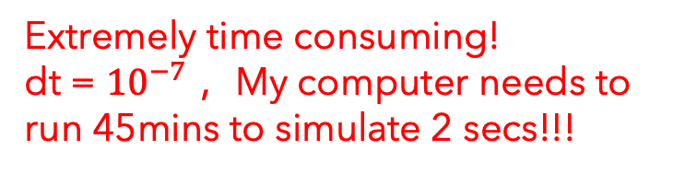
The difficulty of small scale rod simulation
（1）
Softer rod:
Young’s modulus E=$1.4×{10}^{6}$Pa（$kg/(m∗s^{2})$）
Shear modulus E/3 = $4.6×{10}^{5}$Pa
（2）
Density $ρ=2273 kg/m^{3}$
Length $L=3mm=3×{10}^{−3}m$
Radius $r=0.6mm=6×{10}^{−4}m$
Extremely time consuming!
dt = ${10}^{−7}$ ，My computer needs to run 45mins to simulate 2 secs!!!

Slide 16
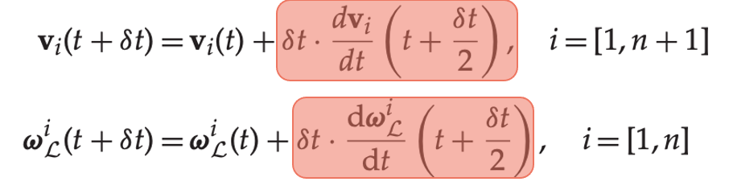
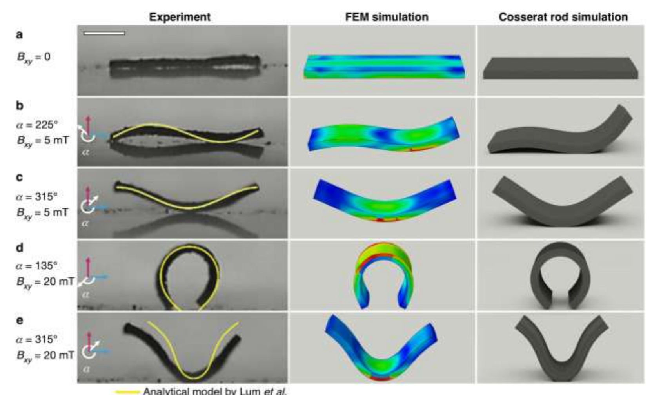
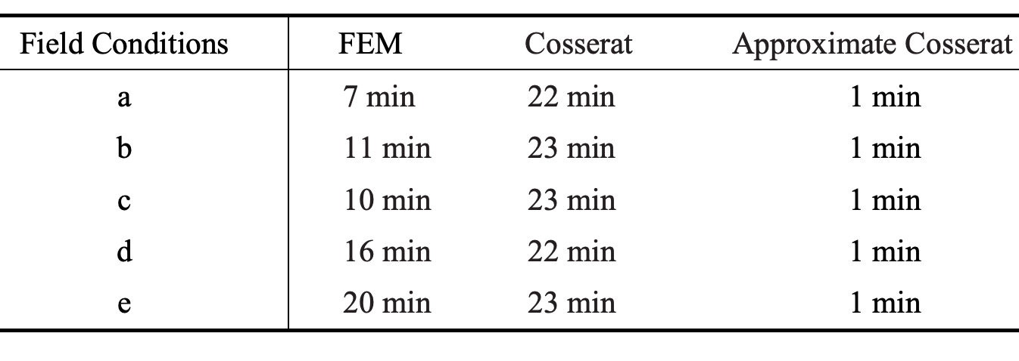

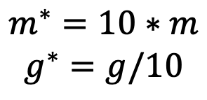
Approximation method
https://github.com/alantes/RL-for-MSRs/issues/2
$$F=ma$$
$$m^{∗}=10∗m$$
$$g^{∗}=g/10$$
Yao, Jianpeng, et al (2023)

Slide 17
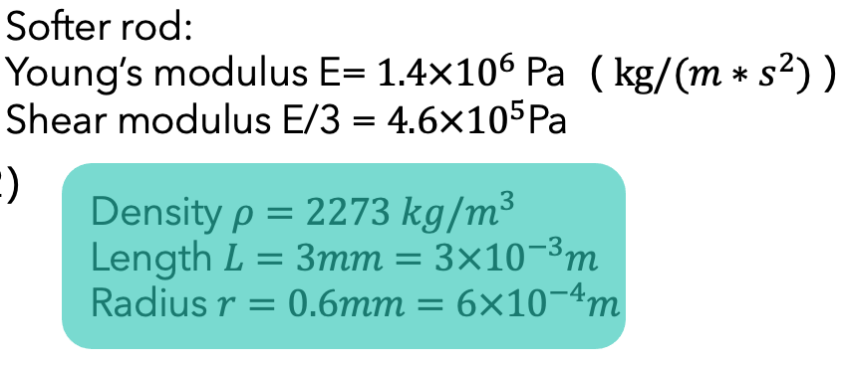
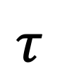
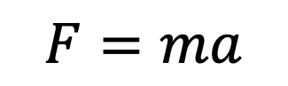
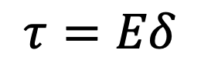
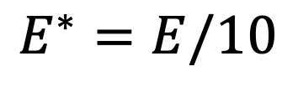
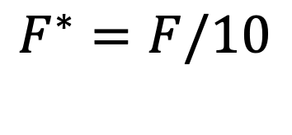
Approximation method
https://github.com/GazzolaLab/PyElastica/issues/310
$$F=ma$$
$$τ=Eδ$$
$$E^{∗}=E/10$$
$$F^{∗}=F/10$$
$$τ$$
Yoonho Kimet al. 2019

Slide 18
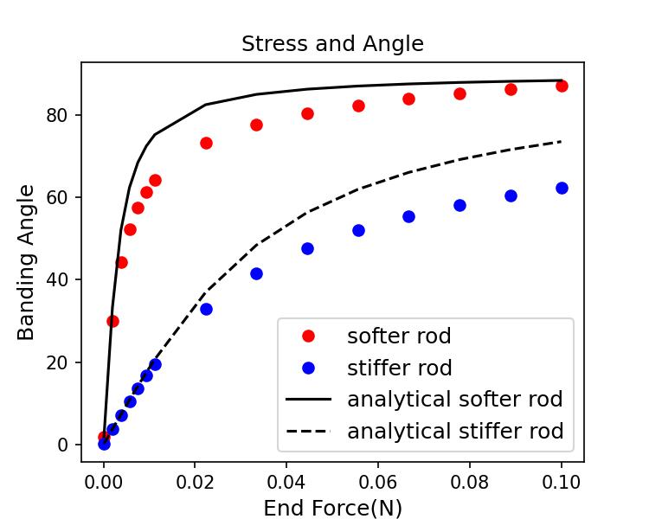
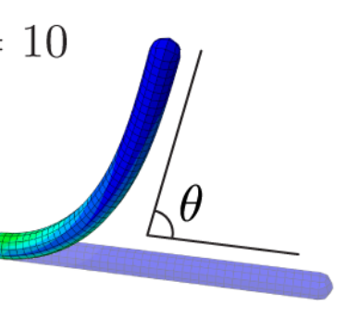
Mechanics and Dynamics of Rods
Yoonho Kimet al. 2019
My computer run 19 secs to simulate 15 secs!!!

Slide 19
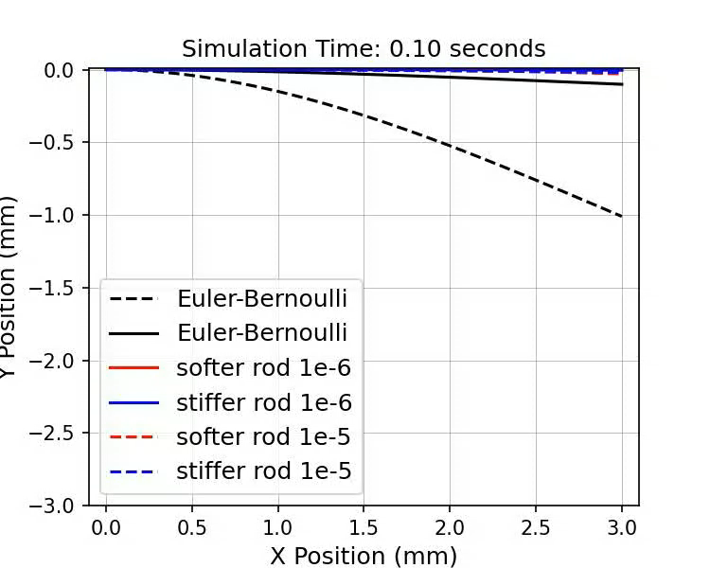
Mechanics and Dynamics of Rods

Slide 20
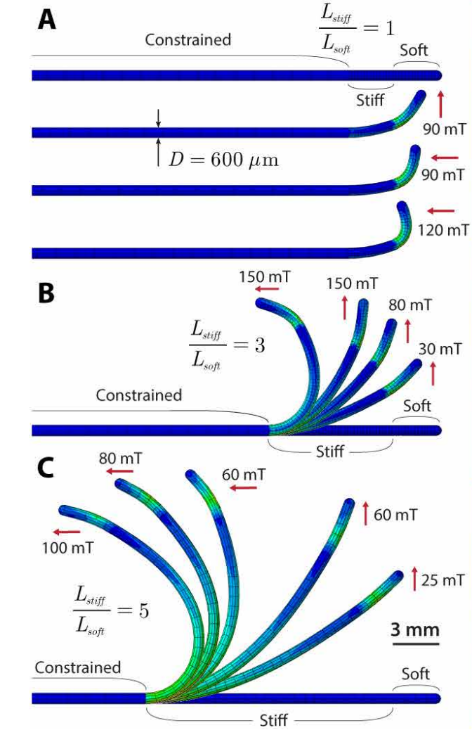
Reproduction
Density $ρ=2273 kg/m^{3}$
Length $L=3mm=3×{10}^{−3}m$
Radius $r=0.6mm=6×{10}^{−4}m$
Uniform Magnetization $M=128 kA/m$
Softer rod:
Young’s modulus E=$1.4×{10}^{6}$Pa
Shear modulus E/3 = $4.6×{10}^{5}$Pa
Stiffer rod:
Young’s modulus E=$1.4×{10}^{7}$Pa
Shear modulus E/3 = $4.6×{10}^{6}$Pa
Yoonho Kimet al. 2019

Slide 21
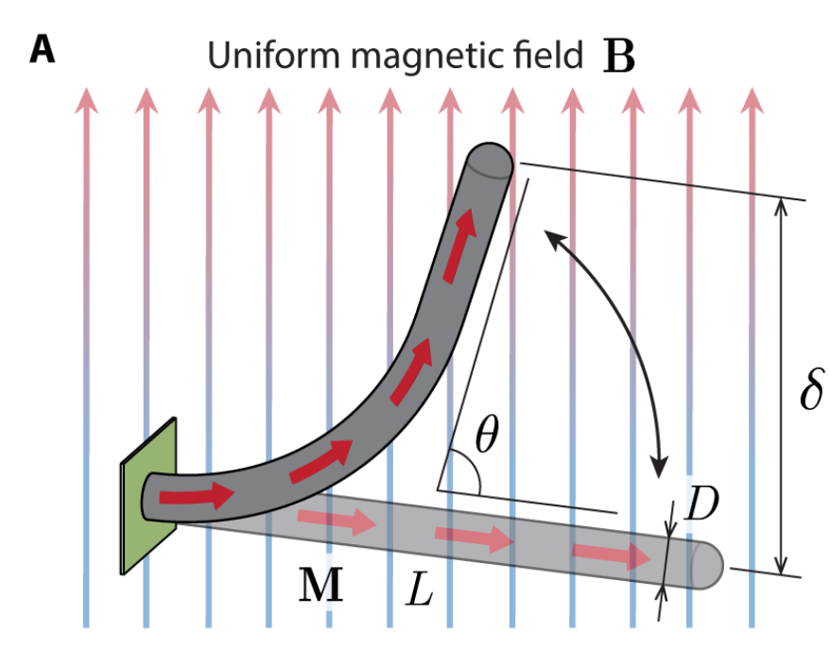
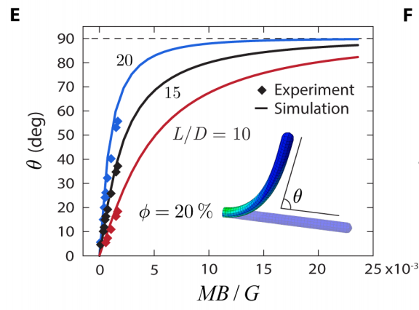
Reproduction
Yoonho Kimet al. 2019

Slide 22
Outline
Joint Rod Simulation
Deflection of Uniform Magnetization Rod under Uniform Magnetic Field
Mechanics and Dynamics of Uniform Magnetization Rods
Outlook

Slide 23
Joint Rod Simulation

Slide 24
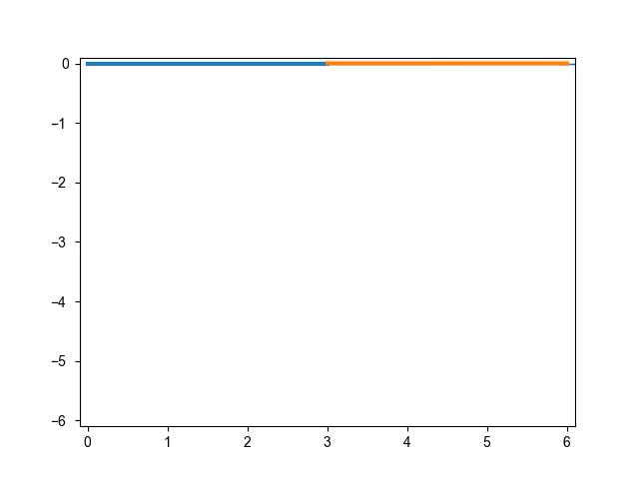
Joint Rod Simulation
F

Slide 25
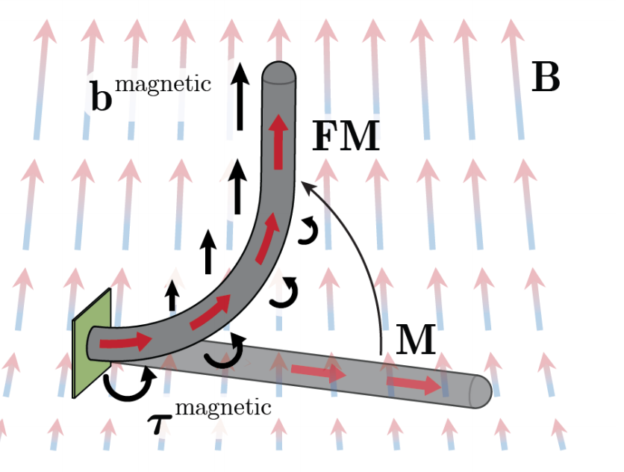
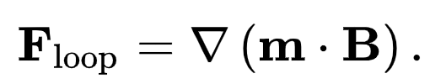
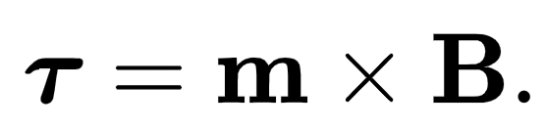
Deflection of Uniform Magnetization Rod
Yoonho Kimet al. 2019

Slide 26
Deflection of Uniform Magnetization Rod
Yoonho Kimet al. 2019

Slide 27
Deflection of Uniform Magnetization Rod
Only torque is considered
Yoonho Kimet al. 2019

Slide 28
Deflection of Uniform Magnetization Rod
Only torque is considered
Yoonho Kimet al. 2019

Slide 29
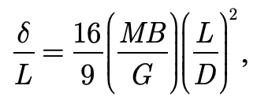
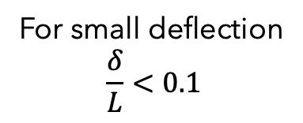
Deflection of Uniform Magnetization Rod
For small deflection
$$\frac{δ}{L}<0.1$$
Only torque is considered
Yoonho Kimet al. 2019

Slide 30
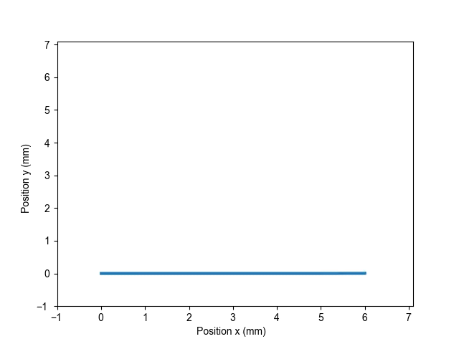
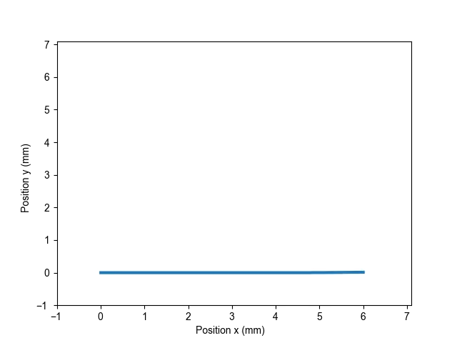
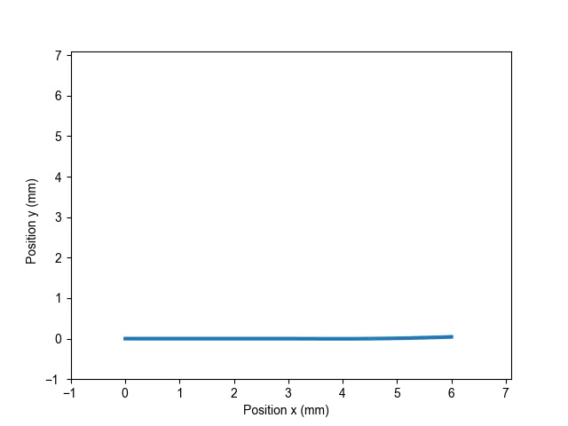
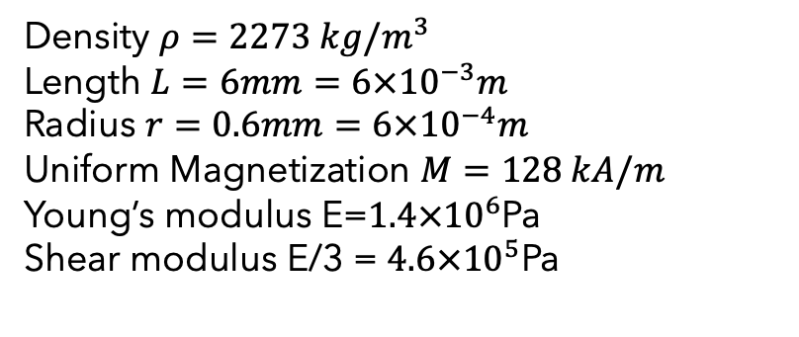
Mechanics and Dynamics of Uniform Magnetization Rods
Density $ρ=2273 kg/m^{3}$
Length $L=6mm=6×{10}^{−3}m$
Radius $r=0.6mm=6×{10}^{−4}m$
Uniform Magnetization $M=128 kA/m$
Young’s modulus E=$1.4×{10}^{6}$Pa
Shear modulus E/3 = $4.6×{10}^{5}$Pa
B = 10mT
B = 30mT
B = 90mT

Slide 31
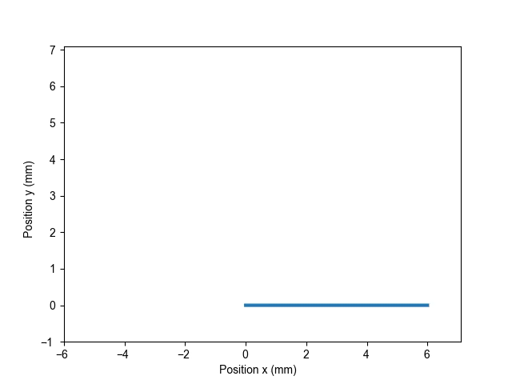
Mechanics and Dynamics of Uniform Magnetization Rods
B = 90mT

Slide 32
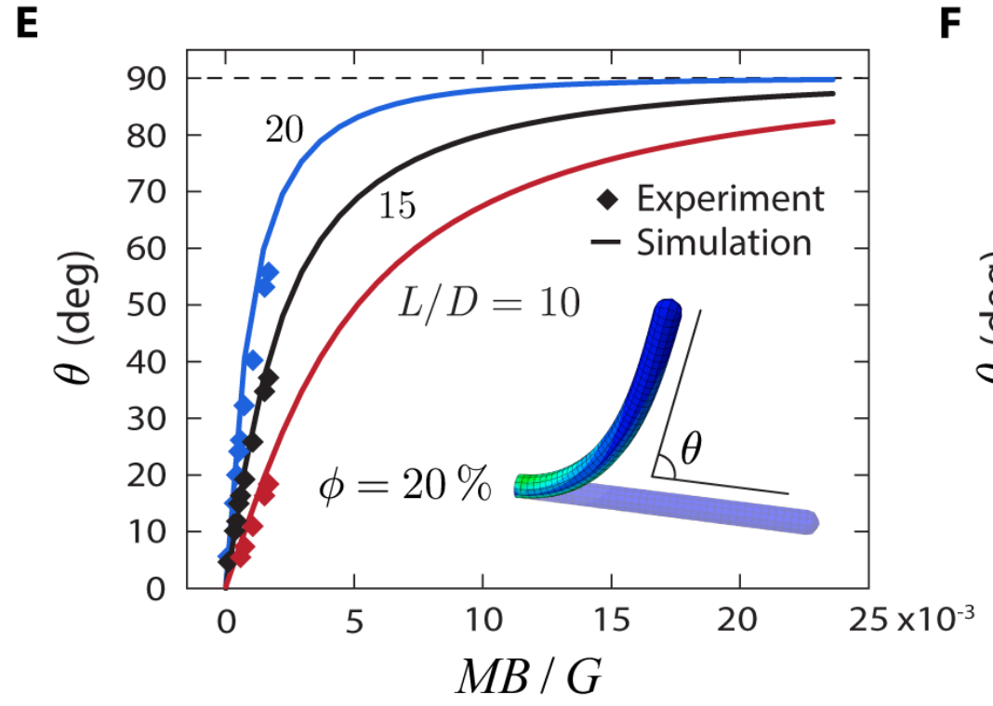
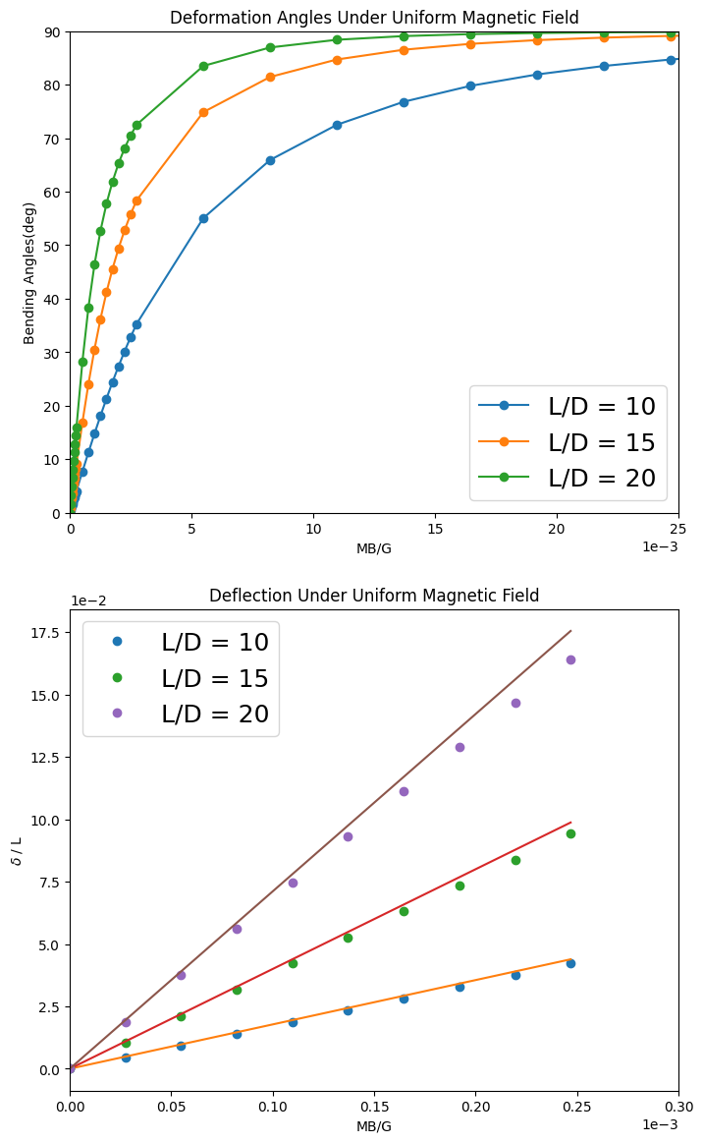
Mechanics and Dynamics of Uniform Magnetization Rods
Yoonho Kimet al. 2019

Slide 33
Mechanics and Dynamics of Uniform Magnetization Rods
Yoonho Kimet al. 2019

Slide 34
Mechanics and Dynamics of Uniform Magnetization Rods

Slide 35
Remark
Joint Rod Simulation
Deflection of Uniform Magnetization Rod under Uniform Magnetic Field
Mechanics and Dynamics of Uniform Magnetization Rods

Slide 36
Outlook
Time depending magnetic field and Real-time simulation
Robot Controlling
To Do List: non-Uniform magnetic field

